Slide 1
External
Local Security Officer
Guide

Slide 2

Course Objectives
This guide will provide you with
  An understanding of the activities required to gain and maintain access to Xoserve Services Portal
  Guidance for the activities to be carried out by a Local Security Officer to:
  Create new users
  Modify User Profile
  Search users
  Service Assignment
The guide is aimed at Local Security Officers (LSO)
To make the most of this guide, follow the steps in the system using the reference as guidance.

Slide 3
Lesson Index
Lesson
Getting Started
User Creation
Modify User Profile
Service Assignment
Service Role Assignment
Additional Administration Activities
6.1 Reset Password
6.2 Service Removal
6.3 Disable User
6.4 Re-enable User
6.5 Unlock User Account
6.6 Delete User
Appendix
A.1 Security Questions
A.2 Reset Password

Slide 4
Lesson 1: Getting Started

Slide 5
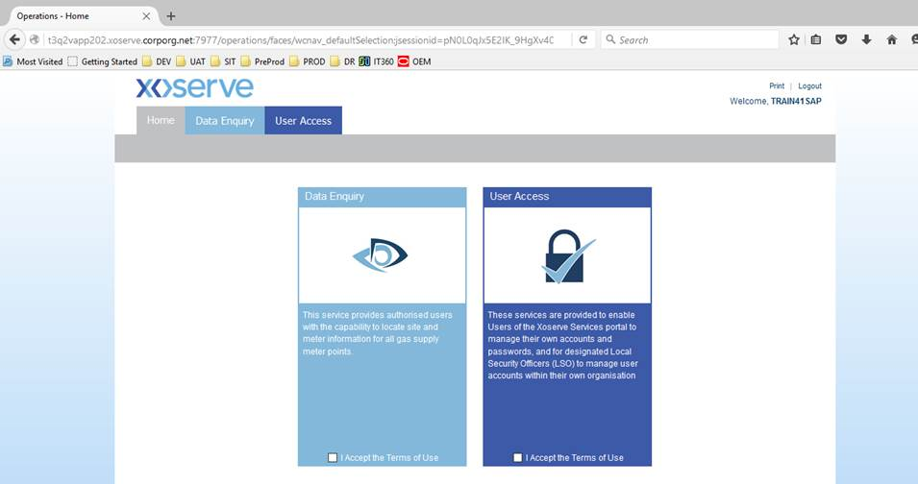
1. Introduction to Xoserve Services Portal Security
Data Enquiry and UK Link will be accessed through the Xoserve Services Portal. All users will require a valid login to access the services.
Xoserve has implemented a new security solution to facilitate Identity and Access Management activities for the Xoserve Services Portal.
Nominated representatives within your organisation called Local Security Officers (LSOs) will manage user access.
In the event that a LSO is unable to complete tasks, Xoserve LSO will act on their behalf.

Slide 6
1.1 Group Organisations
For organisations that are part of a group, the LSOs can be assigned at the Parent company or Child company.
LSOs assigned to the Parent organisation can manage users belonging to both the Parent and Child companies.
The LSO of a Child company can only manage users within their own assigned organisation.
For the sake of this guide, the scenarios are based upon a LSO assigned to the Parent organisation.
LSOs at a Child organisation will follow the same steps. The organisation selection will be limited to the LSO’s own organisation.
Any user associated to the Parent group who is given the Data Enquiry Service role will be able to view all Child portfolio data. For the UK link service Child access is only available.
Parent Company
LSO can manage users for Parent and Child Companies
Child
Company
Child
Company
Child
Company
LSO can manage users for their own company only

Slide 7
1.2.1 External Users – Naming Convention
The User ID is generated automatically by the system using a combination of the user’s name:
  First Name (up to 12 characters) + Last name (up to 10 characters) + number (if duplicate).
  Example: for a user called John Smith, their ID would be generated as JOHNSMITH.
  If there is another user with the same name, a unique number is appended to the User ID – in this example, JOHNSMITH1
If a user is deleted the User ID is not reused. Therefore, any subsequent users with the same name will be created following the principles above.

Slide 8
1.2.2 External Users – Administration
Following a request from an organisation, the LSO is setup by Xoserve.
Once setup, the LSO is responsible for the creation and maintenance of the organisation’s users.
Services are assigned to the user in order to access the system – UK Link and Data Enquiry Service (DES).
New users will automatically receive an email with their User ID details and a second email containing their temporary password to the email address provided.
When a user is created, they will provide responses for a number of security questions. This will enable users to reset their password in the event that they have forgotten. The LSO is also able to reset a password on behalf of the user.
Where an incorrect password is entered 5 times, then the user account is locked. The account must be unlocked by the LSO before the user can gain access.

Slide 9
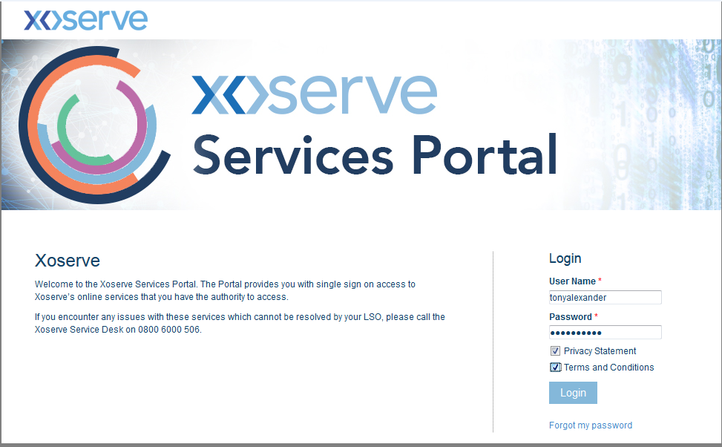
1.3 Login to Xoserve Services Portal
Login
Screen
Password
Reset
Steps
1 | Enter your user name and password.
2 | Check Privacy Statement and Terms and Conditions check-box.
3 | Click the Login button.
Access for users will be via the UK Link Services Portal, using a Single Sign On (SSO) for all SAP Applications.
Next step: Reset the Password

Slide 10
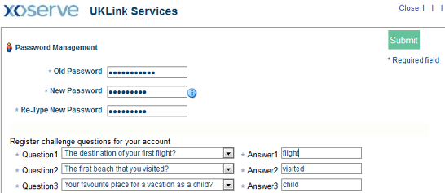
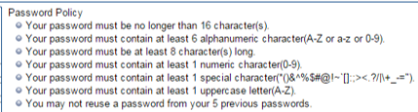
1.4 Reset the Password
Login
Screen
Password
Reset
After logging in for the first time, you will be required to change your temporary password.
Steps
1 | If you are logging into the system for the first time, the Change Password screen appears.
2 | Enter the Old Password and New Password.
3 | Click on the information link to see the password policy rule and a generate new password accordingly.
4 | Set the Security Questions and click the Submit button.
Next step: Click User Access link.

Slide 11






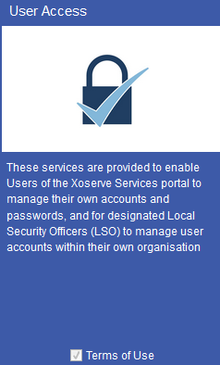
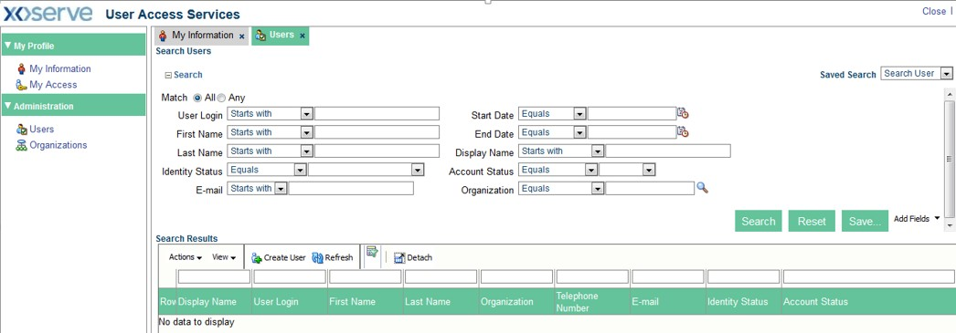


1.5 User Access: Homepage
Login Screen
Password Reset
User Access
Steps
1 | The Xoserve Portal Homepage appears.
2 | Click the User Access link.
3 | The User Access Services screen appears. You can perform different functions through this screen.
END: The user has successfully logged in.

Slide 12
Lesson 2: User Creation

Slide 13
Lesson 2 Introduction
As the LSO for your organisation, you will have the ability to create new users within your organisation.
If you are assigned to a Parent Organisation you will also be able to manage users for any Child Organisations to enable them to access Xoserve Services Portal.
During this lesson, we will complete the steps as a LSO assigned to the Parent organisation to create new users on behalf of a Child organisation.
LSOs at a Child organisation will follow the same steps. The organisation selection will be limited to the LSO’s own organisation.

Slide 14
2. User Creation
2.1.1 Initiate User Creation
User
Access
User
Information
Organisation
Selection
Organisation
Submission
User
Creation
Submission
Email
Notification
User
Search
Updated
User details
After logging into the Xoserve Service Portal following the steps in Lesson 1.3, the services available to you are displayed. To maintain users, select the User Access service.
Steps
1 | The Xoserve Portal Homepage appears. Click the check box to Accept the Terms of Use
2 | Click the User Access link.
Next: The user access Service screen is displayed.

Slide 15
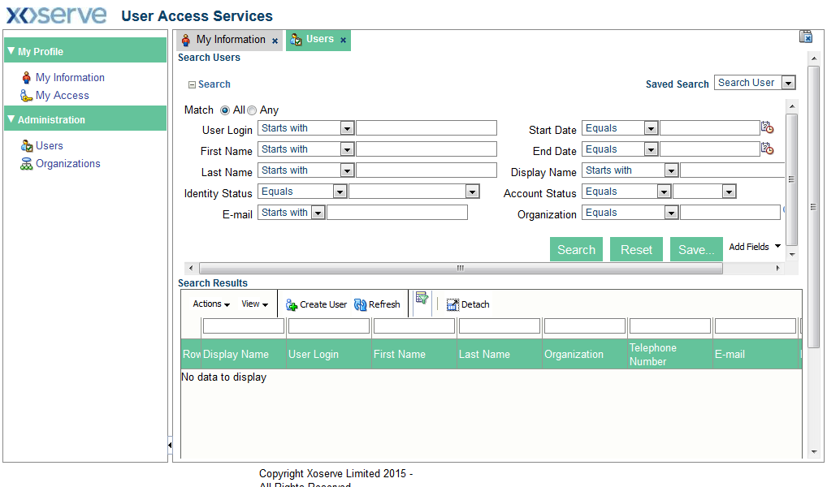
2. User Creation
2.1.2 Initiate User Creation
User
Access
User
Information
Organisation
Selection
Organisation
Submission
User
Creation
Submission
Email
Notification
User
Search
Updated
User details
Steps
1 | To create a Child user, click the Users link. The Users window opens.
2 | Click the Create User link to create a new user.
Next step: Provide user information.

Slide 16
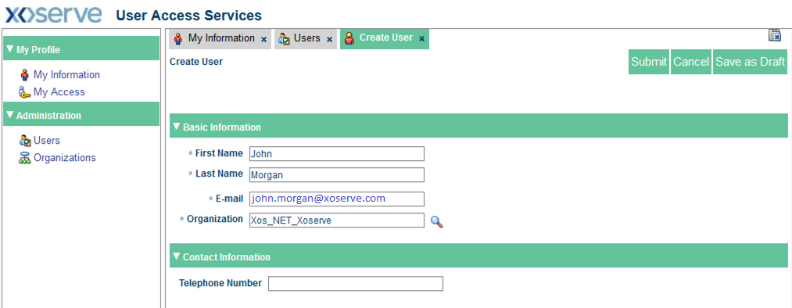
2. User Creation
2.2 Provide User Information
User
Access
User
Information
Organisation
Selection
Organisation
Submission
User
Creation
Submission
Email
Notification
User
Search
Updated
User details
Steps
1 | The Create User window opens.
2 | Provide the required information and click the Search icon..
Next step: Select the child organisation.

Slide 17
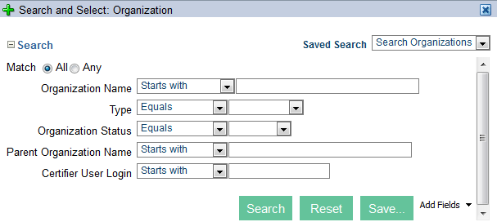
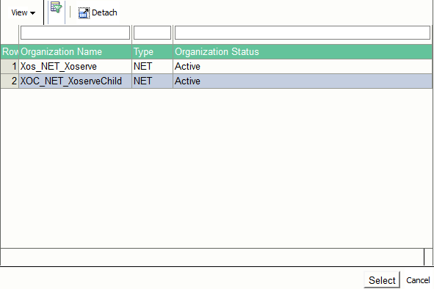
2. User Creation
2.3 Child Organisation Selection
User
Access
User
Information
Organisation
Selection
Organisation
Submission
User
Creation
Submission
Email
Notification
User
Search
Updated
User details
Steps
1 | A Search and Select: organisation screen is displayed.
2 | Click the Search button.
3 | At this stage, you have the option of selecting either Xos_NET_Xoserve (Parent organisation) or XOC_NET_XoserveChild (Child organisation). Select the XOC_NET_XoserveChild and click the Select button.
Next step: Submit the selected organisation.
Note: Organisations within the drop down menu will be specific to those that the LSO can act on behalf of.

Slide 18
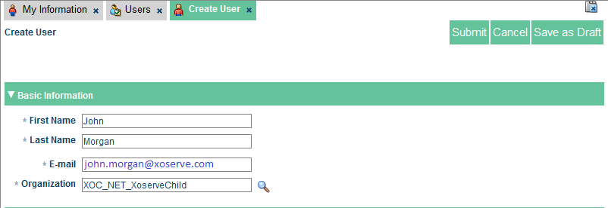
2. User Creation
2.4 Child Organisation Submission
User
Access
User
Information
Organisation
Selection
Organisation
Submission
User
Creation
Submission
Email
Notification
User
Search
Updated
User details
Steps
1 | Click the Submit button.

Slide 19
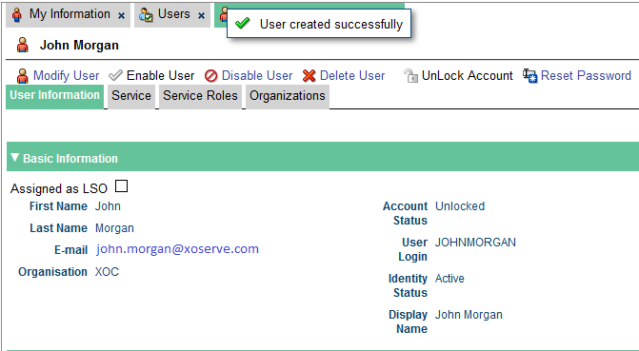
2. User Creation
2.5 User Creation Confirmation
User
Access
User
Information
Organisation
Selection
Organisation
Submission
User
Creation
Submission
Email
Notification
User
Search
Updated
User details
Steps
1 | A confirmation message is displayed: User created successfully with the user details.
2 | To open the Users window, click the Users link.
The User ID is generated automatically as First Name up to 12 characters + Last name up to 10 characters (+ number if duplicate).
For example, for a user called John Smith, their ID would be generated as JOHNSMITH. If there is another user with the same name, the User ID will incremented, for example JOHNSMITH14.

Slide 20
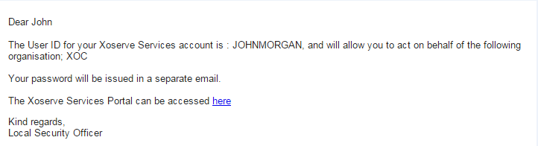
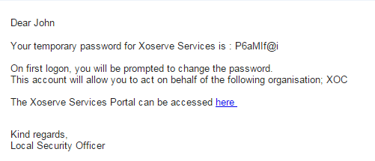
2. User Creation
2.6 Receive Email Notification
User
Access
User
Information
Organisation
Selection
Organisation
Submission
User
Creation
Submission
Email
Notification
User
Search
Updated
User details
Steps
1 | The user will receive two emails notifying them of their User ID (system generated based on their first name and surname) and a Temporary Password.
Next step: Search the user

Slide 21
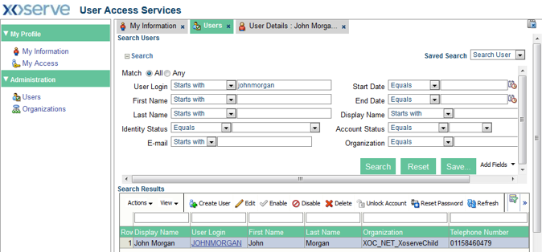
2. User Creation
2.7 Search the User
User
Access
User
Information
Organisation
Selection
Organisation
Submission
User
Creation
Submission
Email
Notification
User
Search
Updated
User details
Steps
1 | To verify that the user has been created, search the user in Users screen.
2 | Enter the user login and click the Search button to initiate search for the user.
3 | Click the user from search results to select it and view their details.
Next step: Verify User details

Slide 22
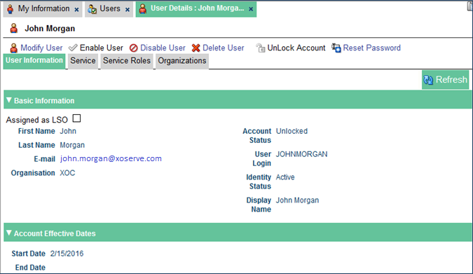
2. User Creation
2.8 Verify User Details
User
Access
User
Information
Organisation
Selection
Organisation
Submission
User
Creation
Submission
Email
Notification
User
Search
Updated
User details
Steps
1 | The User Details window appears. You can check the status and other details of the user in this screen.
2 | The user is currently Active.
END: A new user has been created.

Slide 23
Lesson 3: Modify User Profile

Slide 24
Lesson 3 Introduction
Once the user is created, the LSO is able to amend user details.
You will be able to modify the user’s Last Name, Email address, Organisation (dependent on Organisation group of companies) and telephone number.
Note: the User ID cannot be changed and is not updated if the user’s name or last name is changed.
For LSOs who are assigned to the Parent Organisation can also maintain the users for associated Child Organisations.

Slide 25
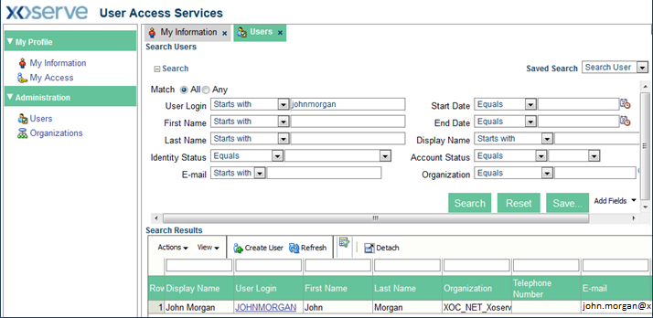
3. Modify User Profile
3.1 Select the User to Modify
User
Search
Profile
Modification
Confirm
Submission
Email
Notification
Updated
User Details
Steps
1 | Click the Users link. The Users window opens.
2 | Enter the user login and click the Search button to search for a specific user.
3 | Click on the user from search results to select it.
Next step: User Details

Slide 26
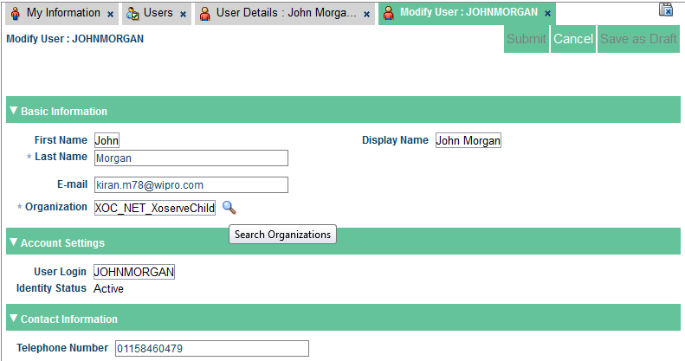
3. Modify User Profile
3.2 Profile Modification
User
Search
Profile
Modification
Confirm
Submission
Email
Notification
Updated
User Details
Steps
1 | User details window is displayed.
2 | Click the Modify User link.
3 | To change the organisation data click Search icon next the Organization field.
Next step: Select organisation and submit

Slide 27
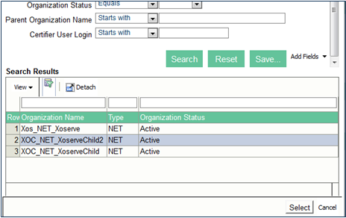

3. Modify User Profile
3.3 Confirm Submission
User
Search
Profile
Modification
Confirm
Submission
Email
Notification
Updated
User Details
Steps
1 | Search and Select: Organization window is displayed.
2 | To view all the available Organisations, click the Search button.
3 | Select the relevant organization from the list and click the Select button. Here, a different child organisation is selected.
4 | A confirmation message is displayed: Successfully Completed the operation.

Slide 28
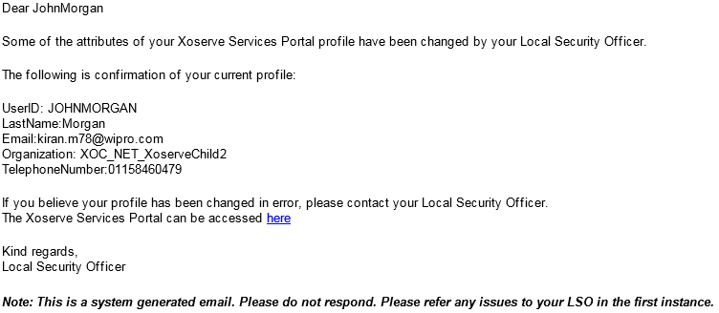
3. Modify User Profile
3.4 Receive Email Notification
User
Search
Profile
Modification
Confirm
Submission
Email
Notification
Updated
User Details
Steps
1 | The users will receive an email notifying the modification made to the user profile.
Next step: Verify the user details.

Slide 29
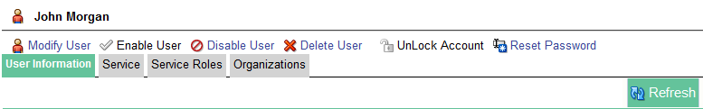
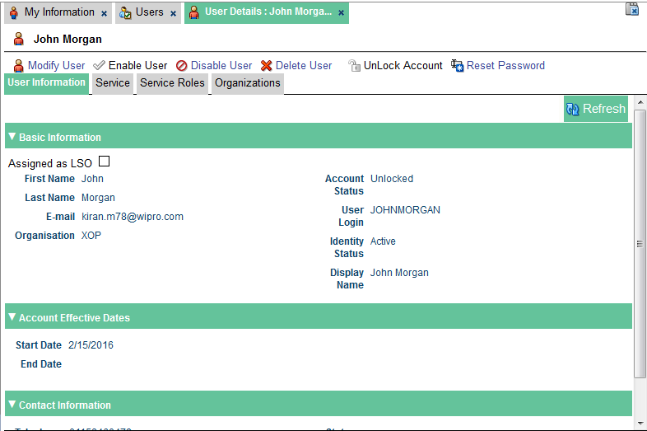
3. Modify User Profile
3.5 Updated User Details
User
Search
Profile
Modification
Confirm
Submission
Email
Notification
Updated
User Details
Steps
1 | To refresh the user information page details, click the Refresh link.
2 | The Organisation data of the user is changed.
END: The user profile has been modified.

Slide 30
Lesson 4: Service Assignment

Slide 31
Lesson 4 Overview
Once the user is created, it is necessary to assign the service roles that the user has. This will determine which applications they have access to, and the permission they have within those applications.
This lesson describes a user at a Parent organisation gaining access to Data Enquiry Service.
This will result in that user having the ability to search on both the Parent and Child Organisations meter portfolio (Portfolio & Community view).

Slide 32
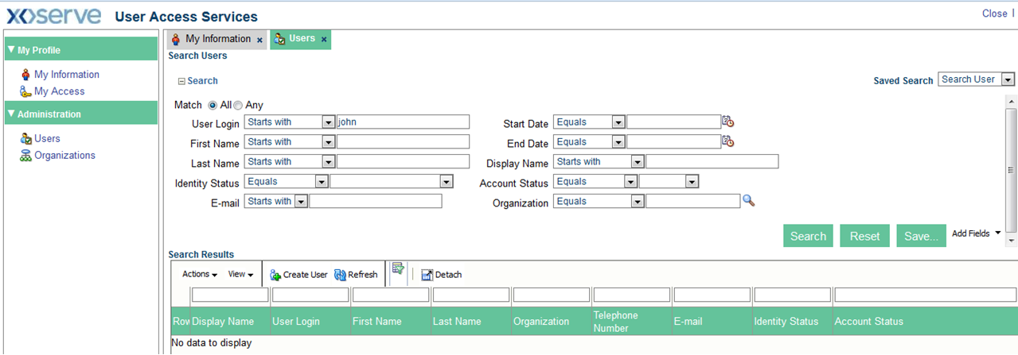
4. Service Assignment
4.1.1 Search the User
User
Search
Service
Assignment
Application
Selection
Confirm
Submission
Email
Notification
Service
Provision
Steps
1 | Click the Users link. The Users window opens.
2 | To view all the user names starting with john, enter the user login as john and click the Search button.

Slide 33
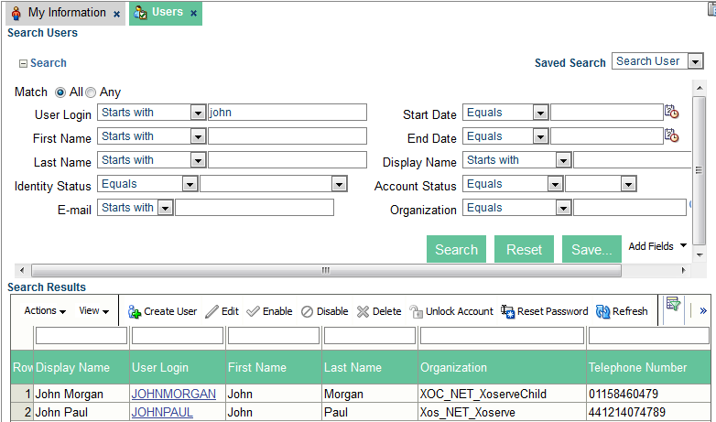
4. Service Assignment
4.1.2 Select User
User
Search
Service
Assignment
Application
Selection
Confirm
Submission
Email
Notification
Service
Provision
Steps
1 | In the Search Results, the user names are displayed having the Parent (Xos_NET_Xoserve) and Child organisation (XOC_NET_XoserveChild).

Slide 34
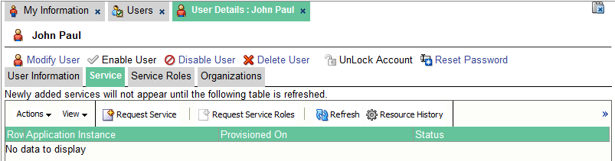
4. Service Assignment
4.2 Service Assignment
User
Search
Service
Assignment
Application
Selection
Confirm
Submission
Email
Notification
Service
Provision
Steps
1 | Click the Service tab.
2 | Click the Request Service link.
Next step: Select the DES application.
Please make sure that you add one Service at a time. To add another Service, repeat the steps from 33 to 37.

Slide 35
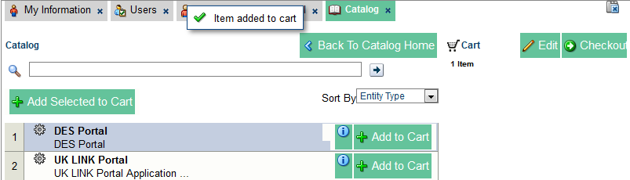
4. Service Assignment
4.3 Application Selection
User
Search
Service
Assignment
Application
Selection
Confirm
Submission
Email
Notification
Service
Provision
Steps
1 | The Catalog window opens.
2 | Currently, the services available are Data Enquiry and UK-Link. Select the DES Portal and click the Add to Cart button.
3 | A confirmation message is displayed: Item added to cart.
4 | Click the Checkout button.
Note: Please be aware that a user at a Parent Organisation can also have UK Link Services assigned to them by the Parent LSO. However due to no portfolio information held at Parent level in UK-Link, they will be unable to return any results.
In the event that this access is needed for a user then a new user account will need to be created (in addition to their Parent user account) at a child organisation level.
Next step: Click the Ready to Submit button.

Slide 36

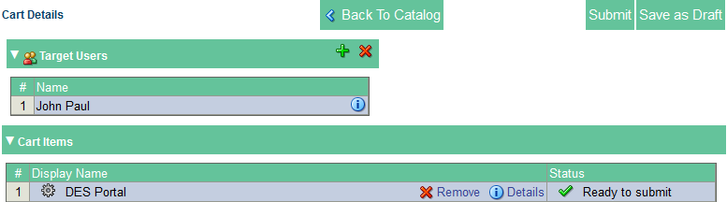
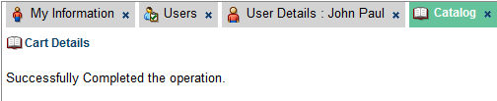
4. Service Assignment
4.4 Confirm Submission
User
Search
Service
Assignment
Application
Selection
Confirm
Submission
Email
Notification
Service
Provision
Steps
1 | Click the Ready to submit button.
2 | The DES Portal application is displayed in the Cart Items section with the status Ready to Submit.
3 | Click the Submit button.
4 | A confirmation message is displayed on the screen, indicating the successful assignment of service.
5 | To go back to the User Details screen, close the Catalog tab.

Slide 37
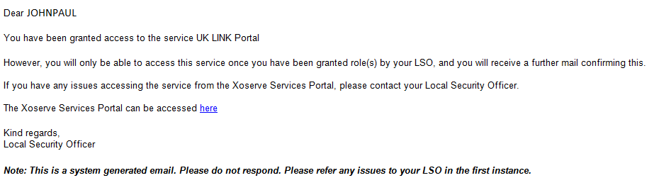
4. Service Assignment
4.5 Receive Email Notification
User
Search
Service
Assignment
Application
Selection
Confirm
Submission
Email
Notification
Service
Provision
Steps
1 | The users will receive an email notifying them of their access to service Data Enquiry Service.
Data Enquiry Service

Slide 38

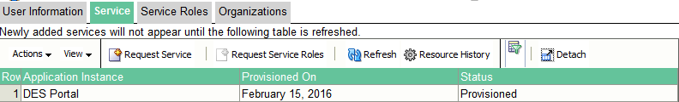
4. Service Assignment
4.6 Verify Service Provision
User
Search
Service
Assignment
Application
Selection
Confirm
Submission
Email
Notification
Service
Provision
Steps
1 | To refresh the page details, click the Refresh link.
2 | The DES Portal application is displayed under Service tab with the status Provisioned.
Note: Please ensure the status of service is provisioned.
END: A new service has been assigned to the user.
Notes:
55555

Slide 39
Lesson 5: Service Role Assignment

Slide 40











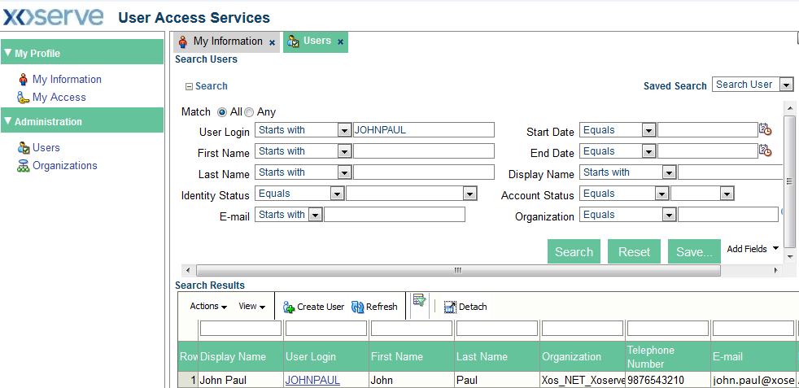


5.1 Search the user
User Search
Service Role Assignment
Service Role Selection
Confirm Submission
Email Notification
Service Role Provision
Steps
1 | Click the Users link. The Users window opens.
2 | Enter the user login and Click the Search button to search for a specific user.
3 | Click on the user from the search results.
Next step: Assign the
Service Role

Slide 41
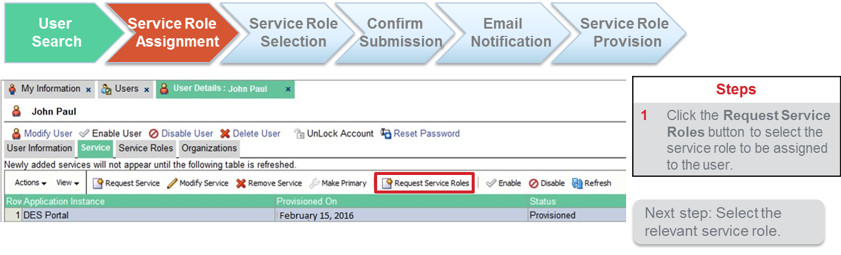
5.2 Service Role Assignment

Slide 42
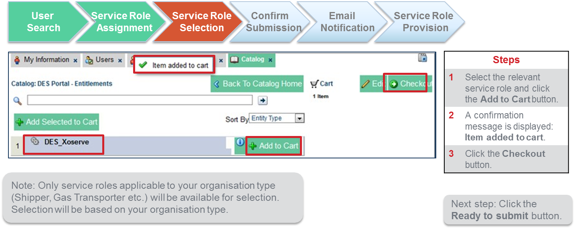
5.3 Role Selection
If multiple roles are required based on your organisation type for example DNO and IGT, please assign one service role at a time.

Slide 43

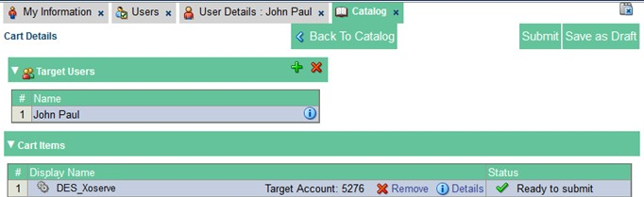
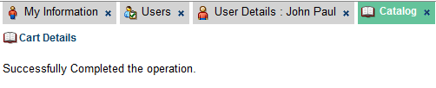
5.4 Confirm Submission
User Search
Service Role Assignment
Service Role Selection
Confirm Submission
Email Notification
Service Role Provision
 |  |  | Steps
 |  |  | 1 | The DES_Xoserve service role is displayed in the Cart Items section with the status Ready to submit.
 |  |  | 2 | Click the Submit button.
 |  |  | 3 | A confirmation message is displayed on the screen, indicating the successful assignment of service role.
 |  |  | 4 | To go back to the User Details screen, close the Catalog tab.

Slide 44
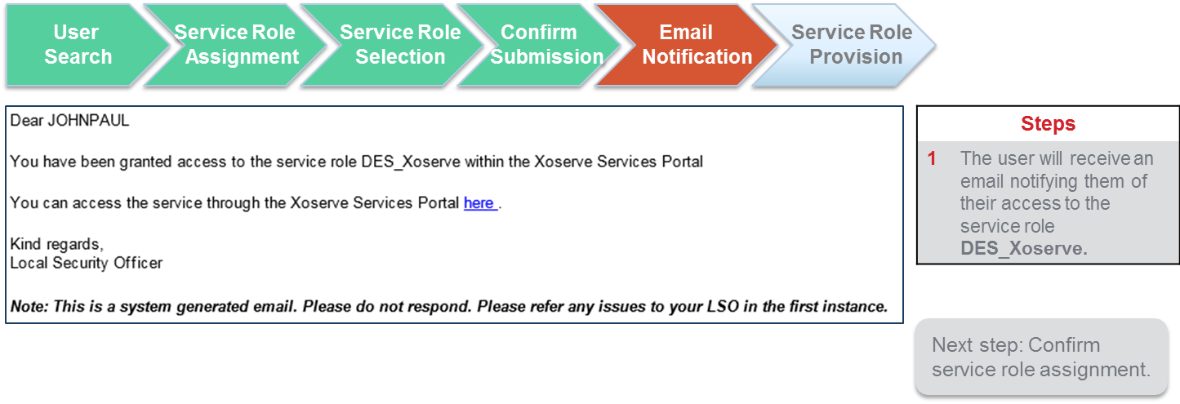
5.5 Receive Email Notification

Slide 45
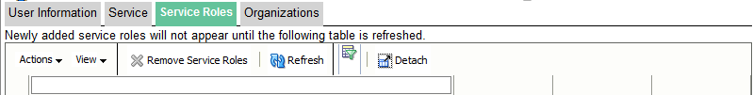
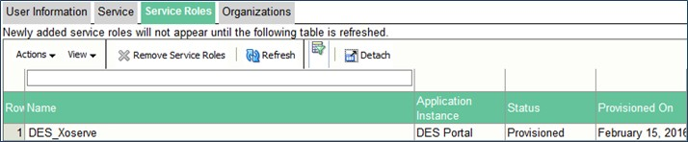


5.6 Verify Service Role Provision
User Search
Service Role Assignment
Service Role Selection
Confirm Submission
Email Notification
Service Role Provision
Steps
1 | To verify that the service role has been allocated to the user, click the Service Roles tab, and click the Refresh link.
2 | The DES_Xoserve service role is displayed under Service roles tab with the status Provisioned.
END: The service role has been assigned to the user.

Slide 46
Lesson 6: Additional Administration
Activities

Slide 47
Lesson 6 Overview
There are additional activities that the LSO can carry out on behalf of their organisation (or that of users in a Child organisation if the LSO is part of the Parent company). The additional activities are described in the following chapters:
 | Activity | Description
6.1 | Reset Password | Users can reset their own passwords using security questions. However, the LSO can reset a password on behalf of a user if required.
6.2 | Service Removal | A service can be removed by the LSO if it is no longer required.
6.3 | Disable User | LSOs will be able to disable a user’s account if, for example, a user is on long term absence. If the user has left the company, the Delete User process should be followed.
6.4 | Re-enable User | A user’s account can be re-enabled following disablement.
6.5 | Unlock User Account | A user account will be locked after five unsuccessful password attempts. If this happens they will be prompted to reset their password (as long as they have set up their Security Questions). However, if required, you can do this on their behalf as the LSO.
6.6 | Delete User | User accounts for your Organisation can be deleted by the LSO. An account cannot be reinstated once deleted. If the user needs to be suspended temporarily, the Disable User process should be followed.

Slide 48
6.1 Reset Password for a User
6.1.1 Search and Select User
For all the administration activities, the first step is to search and select the user required.
Steps
1 | Click the Users link. The Users window opens.
2 | Enter the user login and click the Search button to search for a specific user.
3 | Click on the user from search results.
Next step: Reset Password.

Slide 49
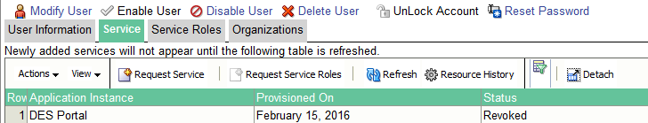
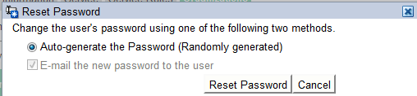

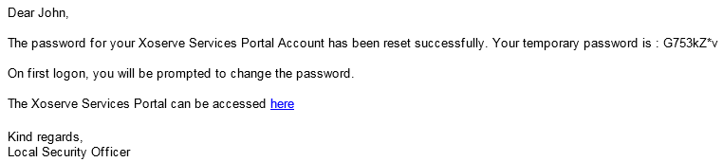
6.1 Reset Password for a User
6.1.2 Password Reset
Steps
1 | Click the Reset Password link.
2 | The Reset Password window is displayed. Click the Reset Password button.
3 | A confirmation message is displayed: Password has been reset successfully
4 | The user will receive an automated email with the temporary password.
Next step: The password is reset.

Slide 50
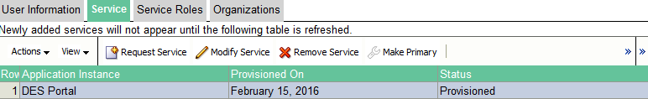
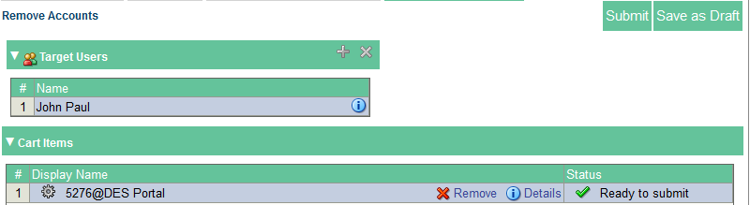

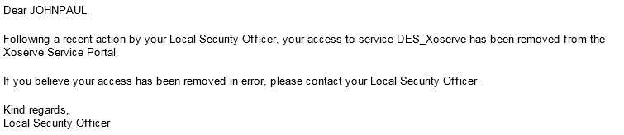
6.2 Service Removal
Steps
1 | Follow the steps in 5.1.1 to search and select the user to modify.
2 | The User details are displayed.
3 | Click the Service tab. As shown in this example, the user is assigned with DES Portal service.
4 | Select the DES Portal service and click the Remove Service link.
5 | The DES Portal application is displayed in the Cart Items section with the status Ready to Submit. Click the Submit button.
6 | A confirmation message is displayed: Successfully Completed the operation.
7 | Close the Remove Accounts tab to return to the User Details screen.
8 | The user will receive an automated email of the change.
END: The service role has been removed.

Slide 51
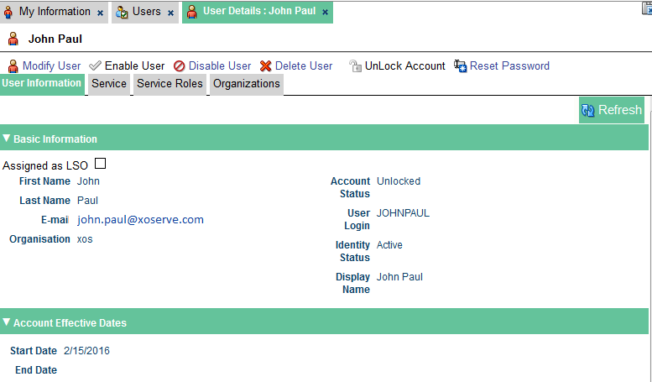
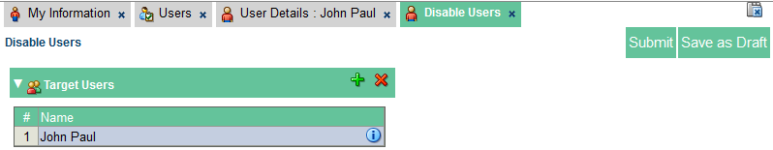

6.3 Disable User
Steps
1 | Follow the steps in 5.1.1 to search and select the user to modify.
2 | The User Details window opens. Note the Identity Status of the user is Active.
6 | Click the Disable User link to disable the user.
7 | The Disable Users window opens.
8 | Click the Submit button to confirm your action.
9 | The confirmation message is displayed conveying that the user has been successfully disabled.
10 | The user will receive an email confirmation.
END: The user has been disabled.

Slide 52
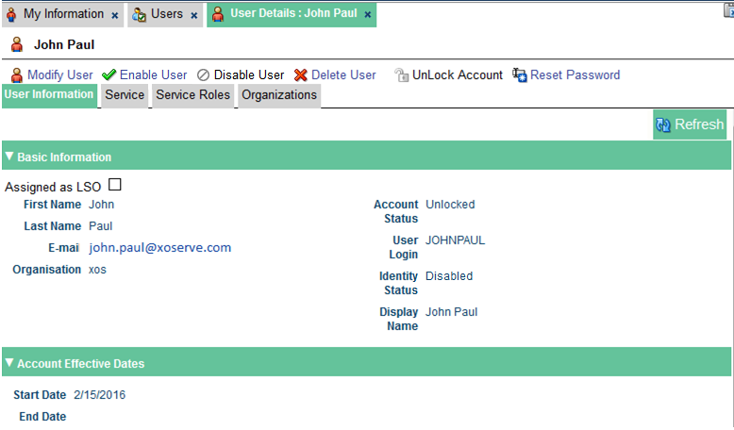
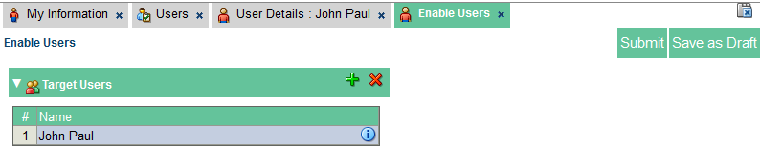

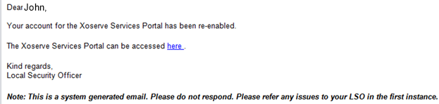
6.4 Re-enable User
Steps
1 | Follow the steps in 5.1.1 to search and select the user to modify. The User Details window opens.
2 | The Identity Status of the user is Disabled.
3 | Click the Enable User link to re-enable the user.
4 | The Enable Users window opens.
5 | Click the Submit button to confirm re-enabling the user.
6 | The confirmation message is displayed conveying that the user has been successfully re-enabled.
7 | The Identity Status has changed back to Active. The user will receive a confirmation email.
End: the user is re-enabled.

Slide 53





6.5 Unlock Account
Steps
1 | User will receive a mail stating the account has been locked.
2 | Follow the steps in 5.1.1 to search and select the user to modify.
3 | Notice, currently the account status is Locked.
4 | Click the Unlock Account link to unlock user account. Note: If the Account Status was showing as Unlocked, this action button would be greyed out.
5 | Click the Unlock button to confirm your action.
6 | A confirmation message is displayed: Account unlocked successfully.
7 | The user will receive an email notifying them the account unlock confirmation. Note: the password reset is optional, as some users may have remembered their correct password after being locked out.

Slide 54



6.6 Delete User
Steps
1 | Follow the steps in 5.1.1 to search and select the user to modify. The User Details window opens.
2 | Click the Delete User link to delete the user.
3 | The Delete Users window opens.
4 | Click the Submit button to confirm your action.
5 | The confirmation message is displayed indicating the user has been successfully deleted.
6 | The users will receive an email notification informing that the account is deleted.
END: The user has been deleted.

Slide 55
Appendix: Password Reset

Slide 56

Appendix
A.1 User Security Questions
  A user will set up their security questions and answers to allow password resets. Once set up, they cannot be viewed but can be edited via:
  User Access > My Information > Security Questions
  Select the question from the drop down list. There are a variety of questions which the user can pick.
  Enter the response in the answer. The response is not case-sensitive.
  The user will be required to enter the correct answer for all 3 questions in order to reset their password.
  When complete, press Apply to save the changes.

Slide 57


Appendix
A.2.1 Password Reset
Portal
Login
Enter
User ID
Security
Questions
Enter
New
Password
Confirmation
Passwords can be reset by the user either automatically where there has been a number of failed attempts, or upon request when the password has been forgotten.
Steps
1 | The user can select Forgot My Password option to reset their password; or if the user has failed to login successfully, the system will automatically prompt to reset the password.
Next step: Enter user login ID.

Slide 58


Appendix
A.2.2 Enter User ID & Security Questions
Portal
Login
Enter
User ID
Security
Questions
Enter
New
Password
Confirmation
Steps
2 | Enter the User Login ID to reset and press enter.
3 | The security questions that were set up for the account are displayed. Enter the appropriate answers for each question. The answers are not case-sensitive. Enter Tab to move between questions and Enter upon completion.
Note: The answers given are not validated immediately.
Next step: Enter new password

Slide 59


Appendix
A.2.3 Enter New Password
Portal
Login
Enter
User ID
Security
Questions
Enter
New
Password
Confirmation
Steps
4 | The password entry screen displays. Enter the new password following the rules shown.
5 | Re-enter the password so that it matches the new password entered.
Note: The password is not validated until the user has pressed Enter.
Next step: Confirmation.

Slide 60




Appendix
A.2.4 Password Confirmation
Portal
Login
Enter
User ID
Security
Questions
Enter
New
Password
Confirmation
Steps
6 | If the password has been updated correctly, the system displays confirmation.
5 | Error messages are displayed where the password or questions have not been provided correctly.
End: Password reset.

Slide 61
Course Summary
At the end of this course, you have learnt to perform the following activities as a LSO in a parent organisation as well as in child organisation.
  Create new users
  Modify users profile
  Search users
  Service Assignment
  Service Role Assignment

Slide 62

Thank You!

