Slide 1
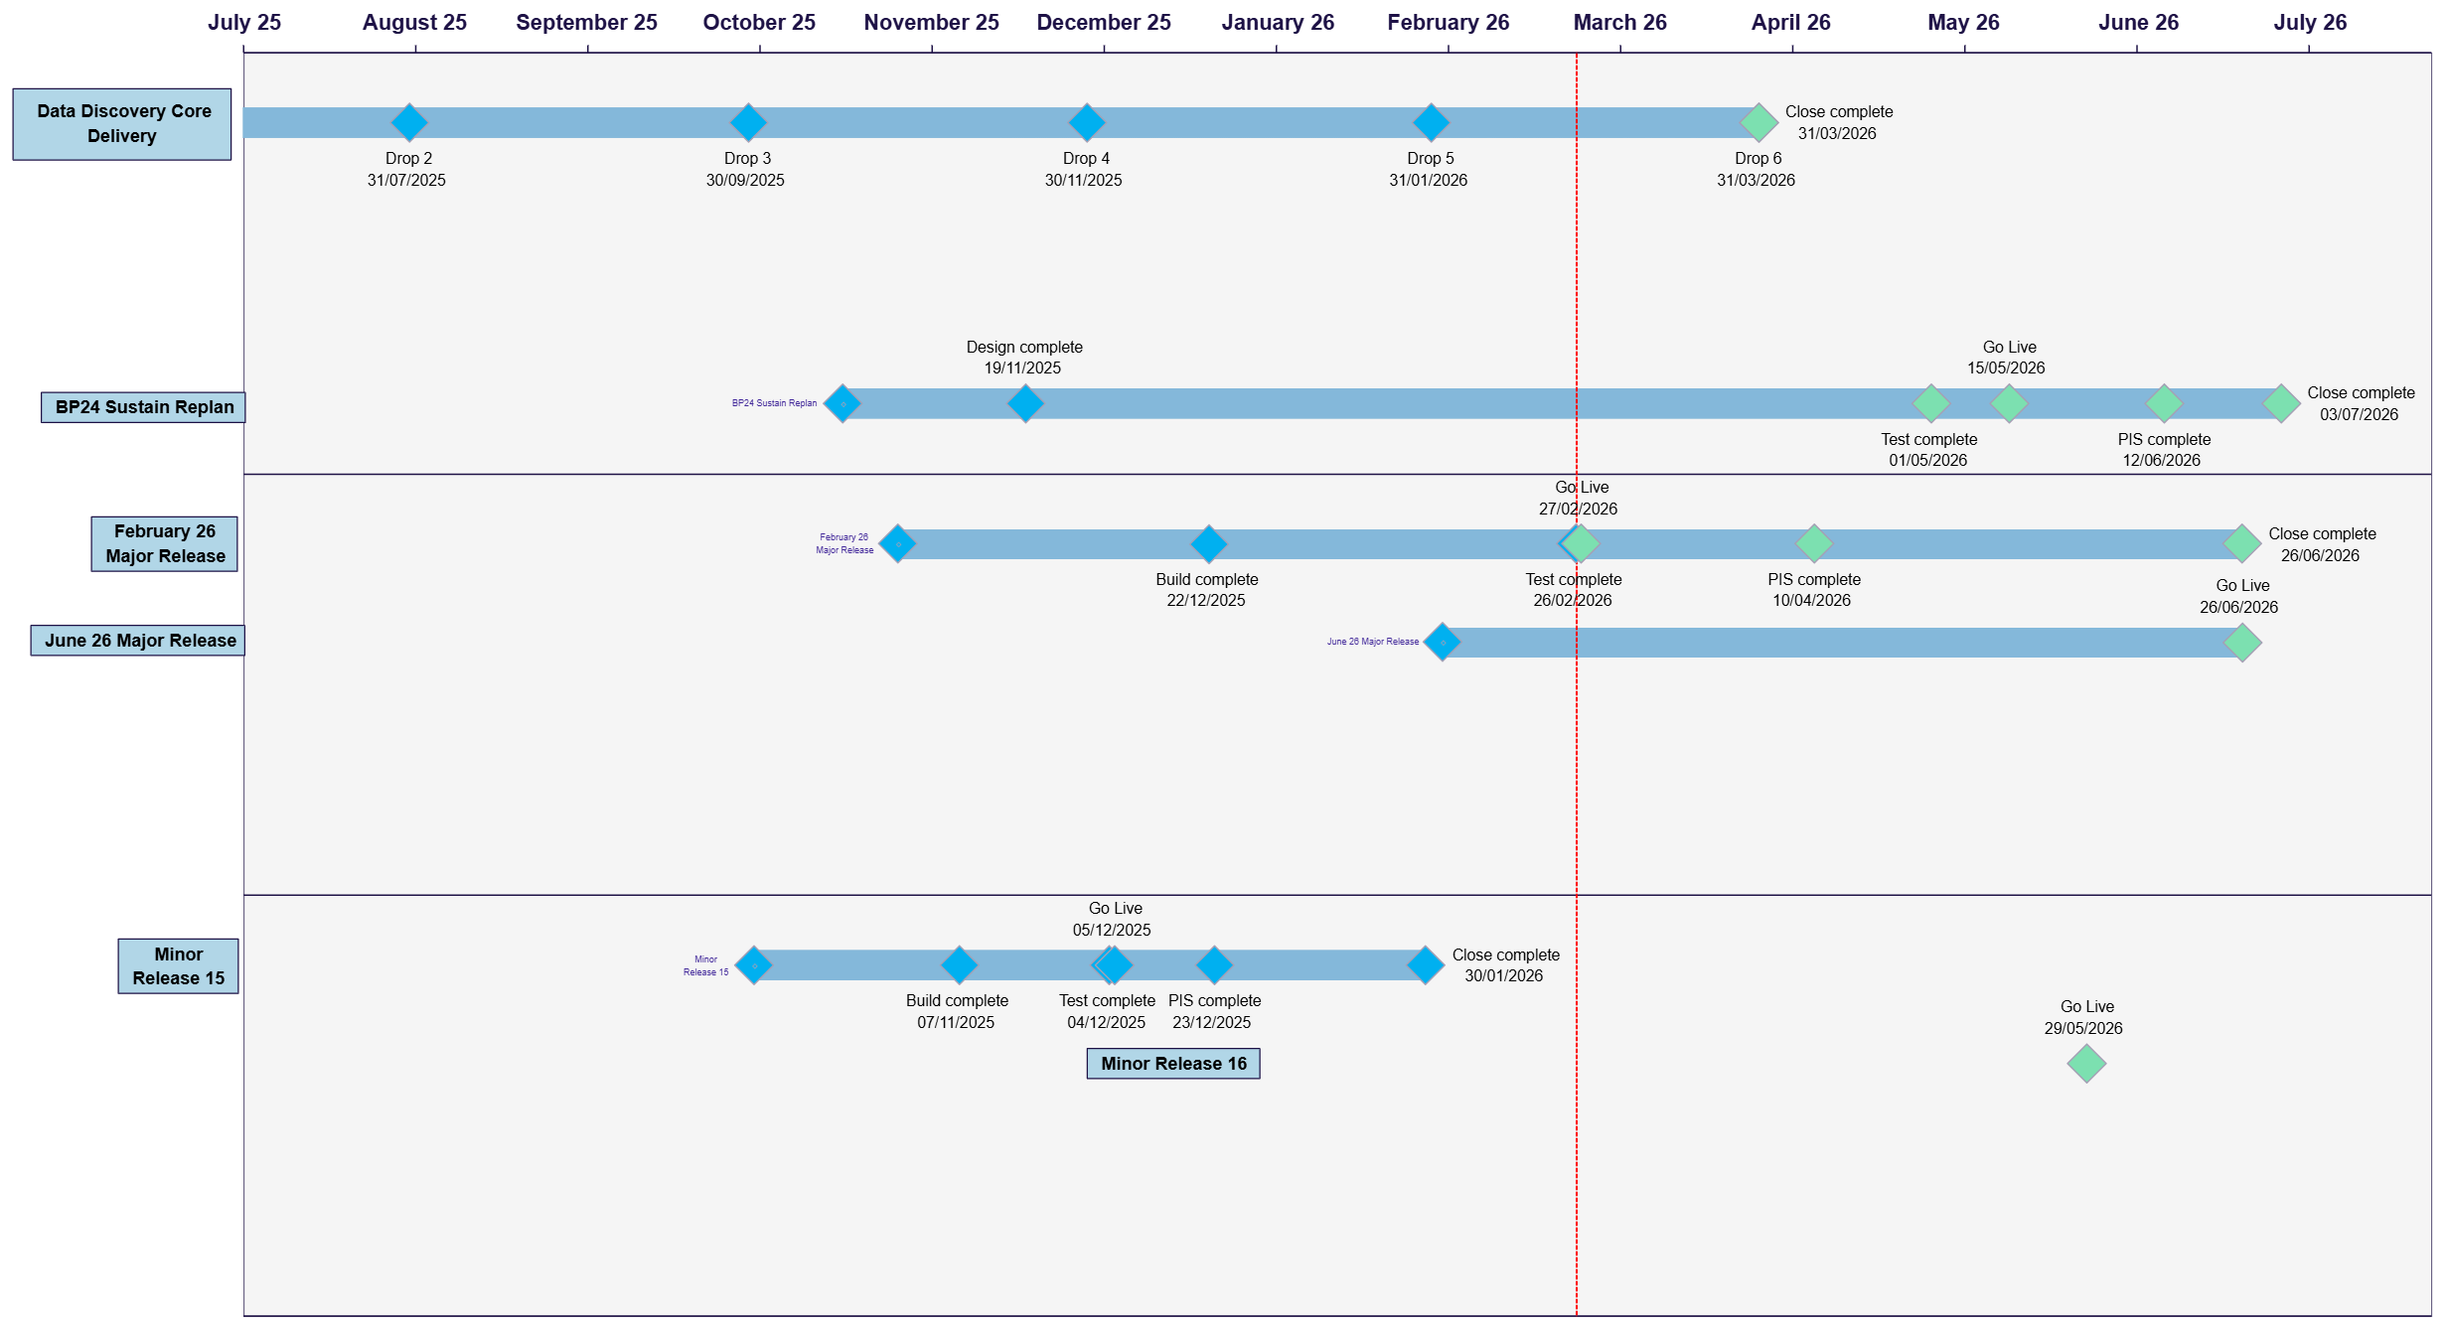
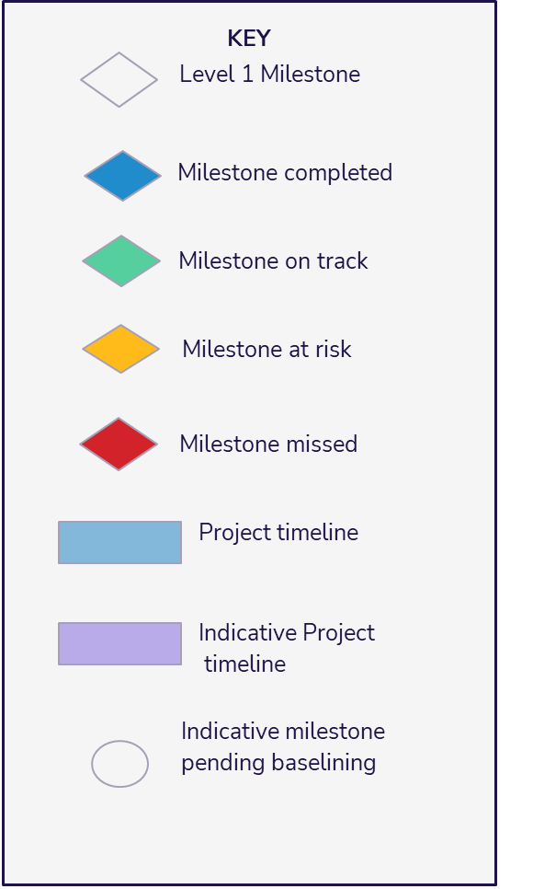
Portfolio Plan On a Page
Version: 1
Issued: 25/02/2026
Uncontrolled when printed
© Xoserve
Notes:
Add bullets

